Slide 1

CSE438 Paper Presentation
Topic- Calibration of Serial Robots through Integration of Local POE Formula and Artificial Neural Networks
Name- Zaki Habib
Id- 19201073
Section- 01

Slide 2
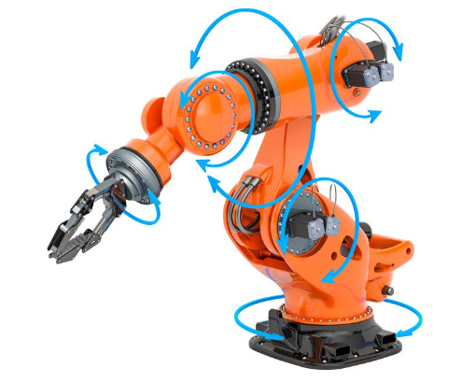
Introduction -
Robotics manipulators are essential
Industrial robots have advantages
Low cost
Lacks absolute pose accuracy

Slide 3
Methods- 1)Model Based methods-
Building relationships between pose errors and error sources
Two approach – D-H convention and Product of Matrix Exponentials
Has several limitations

Slide 4
Methods- 2)Data-Driven Methods-
Takes pose errors as functions of configuration
Applies Interpolation method and fitting method
Also has several limitations

Slide 5
Methodology-
Integration of Model-Based and Data-Driven Methods
Building of equivalent robot for calibration
Simplifying error modeling
Maintaining high accuracy in compensating for pose errors

Slide 6
Modeling- 1)Actual Robot
Forward Kinematic Model based on Local POE Formula
Linearized Error Model based on Local POE Formula
Limitations:
1) Redundancy
2) Accuracy
3) Minimality

Slide 7
Modeling- 2)Equivalent Robot
Simplification of Local POE-based Error Model by Keeping Joint Motion Errors
Approximation of Configuration-dependent Joint Motion Errors Using Artificial Neural Networks
Benefits:
1) Simplicity
2) Accuracy
3) Ease of Error Compensation

Slide 8
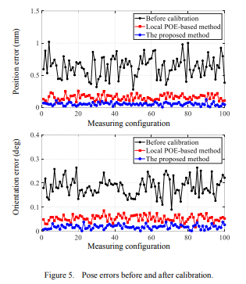
Results-
Position and Orientation errors are reduced.
Pose accuracy is increased
Standard Deviation of pose errors are reduced
Proposed model outperforms traditional method

Slide 9
Conclusion-
New or Novel Calibration Method
Effective for Serial Robot
Challenges remains when applying on parallel robot

